Slide 1
Module 3
Classification
Naive Bayes Classifier
‹#›

Slide 2
Bayesian Classification: Why?
Bayesian classifiers are Statistical classifiers
They can predict class membership probabilities such as the probability that a given tuple belongs to a particular class.
Bayesian Classification is based on Bayes’ Theorem.
Performance:
Comparable performance with decision tree .
Exhibited high accuracy and speed when applied to large databases.
Assumptions:
1. Na¨ıve Bayesian classifiers assume that the effect of an attribute value on a given class is independent of the values of the other attributes. This assumption is called class conditional independence.
2. Features are equally important: All features are assumed to contribute equally to the prediction of the class label.
‹#›
Notes:
‹#›

Slide 3
Bayes’ Theorem
Bayes’ Theorem finds the probability of an event occurring given the probability of another event that has already occurred. Bayes’ theorem is stated mathematically as the following equation:
where A and B are events and P(B) ≠ 0
Basically, we are trying to find probability of event A, given the event B is true. Event B is also termed as evidence.
P(A) is the priori of A (the prior probability, i.e. Probability of event before evidence is seen). The evidence is an attribute value of an unknown instance (here, it is event B).
P(B) is Marginal Probability: Probability of Evidence.
P(A|B) is a posteriori probability of B, i.e. probability of event after evidence is seen.
P(B|A) is Likelihood probability i.e the likelihood that a hypothesis will come true based on the evidence.

Slide 4
Naïve Bayesian Classification Algorithm
Naïve Bayes algorithm is a supervised learning algorithm, which is based on Bayes theorem and used for solving classification problems.
Naïve Bayes Classifier is one of the simple and most effective Classification algorithms which helps in building the fast machine learning models that can make quick predictions.
It is a probabilistic classifier, which means it predicts on the basis of the probability of an object.
Some popular examples of Naïve Bayes Algorithm are spam filtration, Sentimental analysis, and classifying articles.
‹#›

Slide 5
Naïve Bayesian Classification
Why is it called Naïve Bayes?
The Naïve Bayes algorithm is comprised of two words Naïve and Bayes, Which can be described as:
Naïve: It is called Naïve because it assumes that the occurrence of a certain feature is independent of the occurrence of other features.
Bayes: It is called Bayes because it depends on the principle of Bayes' Theorem.
‹#›

Slide 6
Naïve Bayesian Classification
For the given dataset, we can apply Bayes’ theorem as:
where, y is class variable and X is a dependent feature vector (of size n)
where:x=(x1,x2,....xn)
Now, as the denominator remains constant for a given input, we can remove that term:
To create a Naive Baayes classifier model. we find the probability of given set of inputs for all possible values of the class variable y and pick up the output with maximum probability.
i.e We need to maximize P(X|y_{i}) x P(y_{i}), for i = 1, 2, …. n

Slide 7
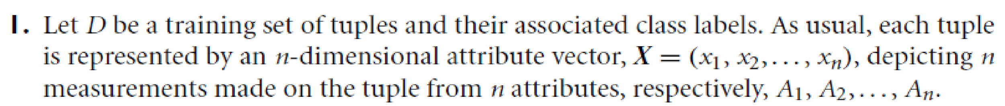
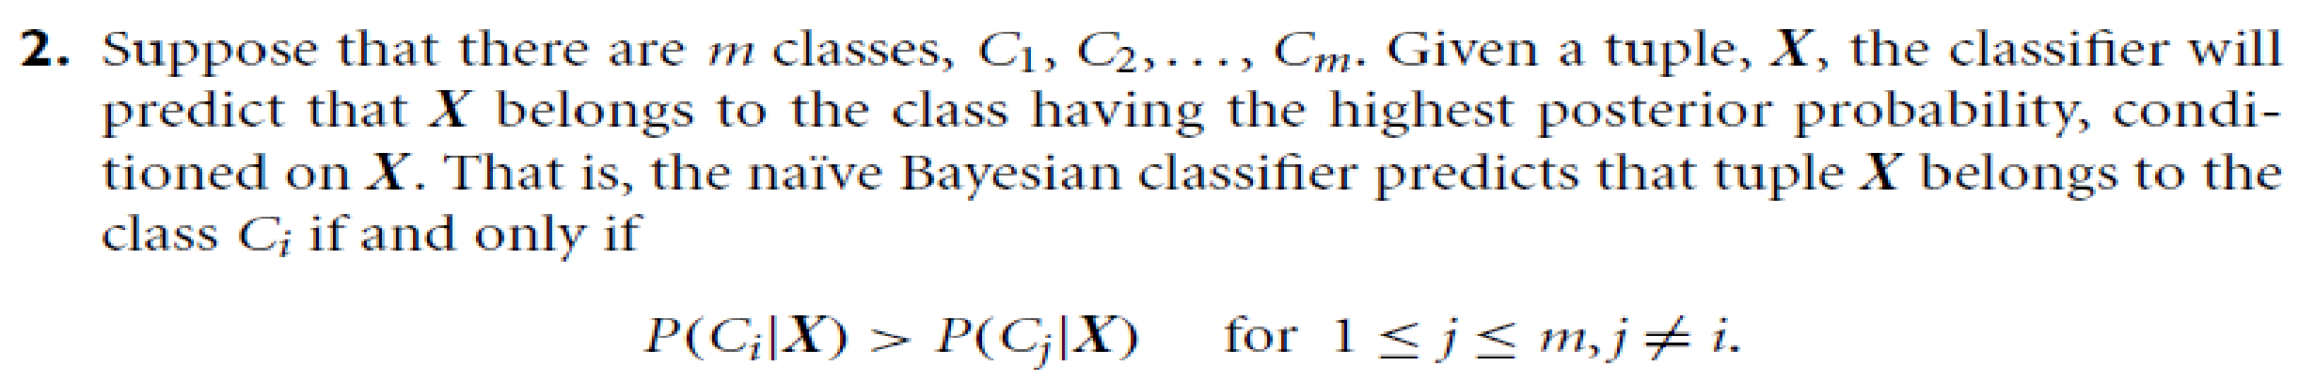
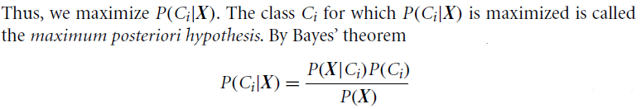
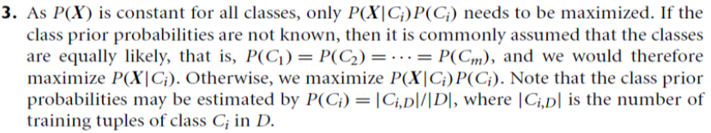
Naïve Bayesian Classification
‹#›

Slide 8
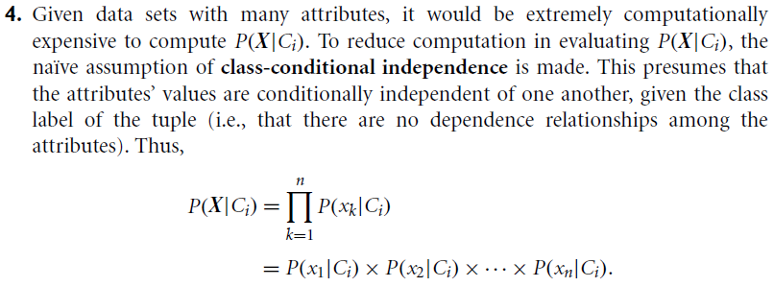
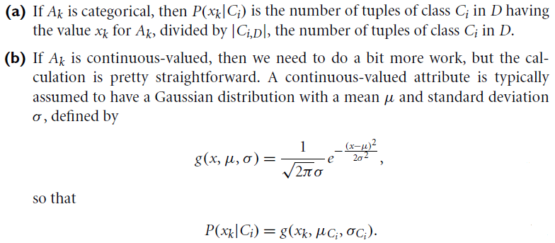
Naïve Bayesian Classification(Cntd..
‹#›

Slide 9
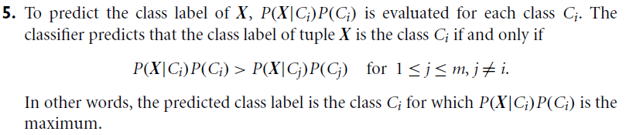
Naïve Bayesian Classification(Cntd..
‹#›

Slide 10
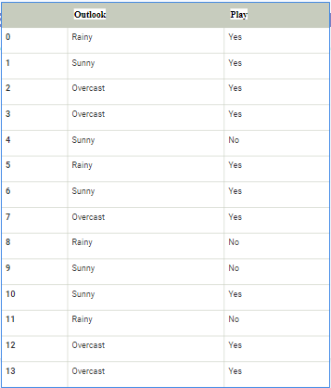
Naïve Bayesian Classification Example
Problem: If whether is sunny,then player should play or not?
‹#›

Slide 11
Create Frequency table for weather conditions
Applying Bayes'theorem:
P(Yes|Sunny)= P(Sunny|Yes)*P(Yes)/P(Sunny)
P(Sunny|Yes)= 3/10= 0.3
P(Sunny)= 0.35
P(Yes)=0.71
So P(Yes|Sunny) = 0.3*0.71/0.35= 0.60
Weather | Yes | No
Overcast | 5 | 0
Rainy | 2 | 2
Sunny | 3 | 2
Total | 10 | 5
P(No|Sunny)= P(Sunny|No)*P(No)/P(Sunny)
P(Sunny|NO)= 2/4=0.5
P(No)= 0.29
P(Sunny)= 0.35
So P(No|Sunny)= 0.5*0.29/0.35 = 0.41
So as we can see from the above calculation that P(Yes|Sunny)>P(No|Sunny)
Hence on a Sunny day, Player can play the game.

Slide 12
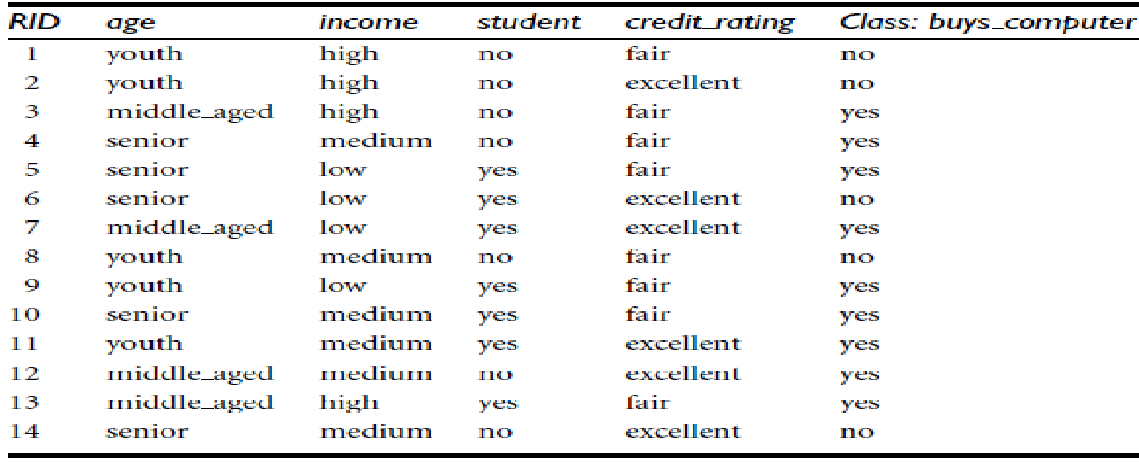
Example: Predicting a class label using Naïve Bayesian classification
The data tuples are described by the attributes age, income, student, and credit rating.
The class label attribute, buys computer, has two distinct values (namely, {yes, no}).
Let C1 correspond to the class buys computer = yes and C2 correspond to buys computer = no.
The tuple we wish to classify is
‹#›

Slide 13
Example: Predicting a class label using Naïve Bayesian classification
The tuple we wish to classify is
‹#›

Slide 14
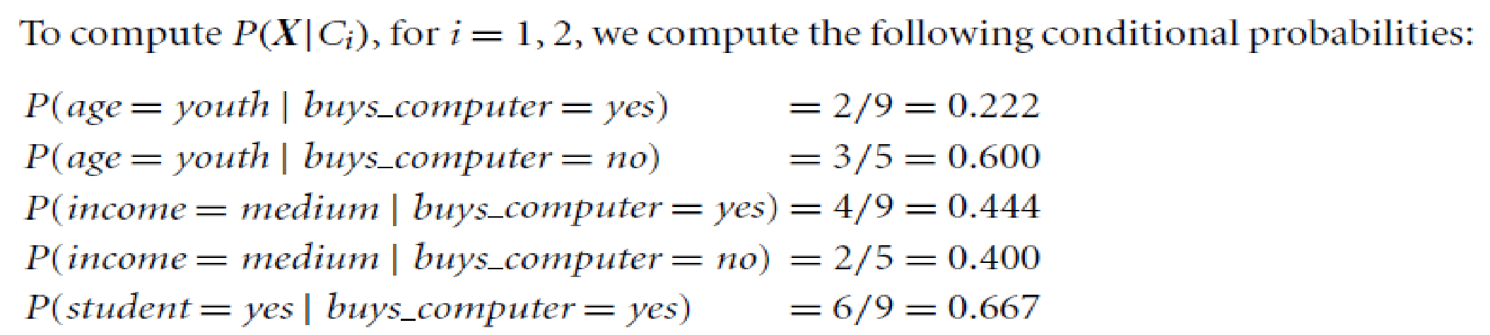
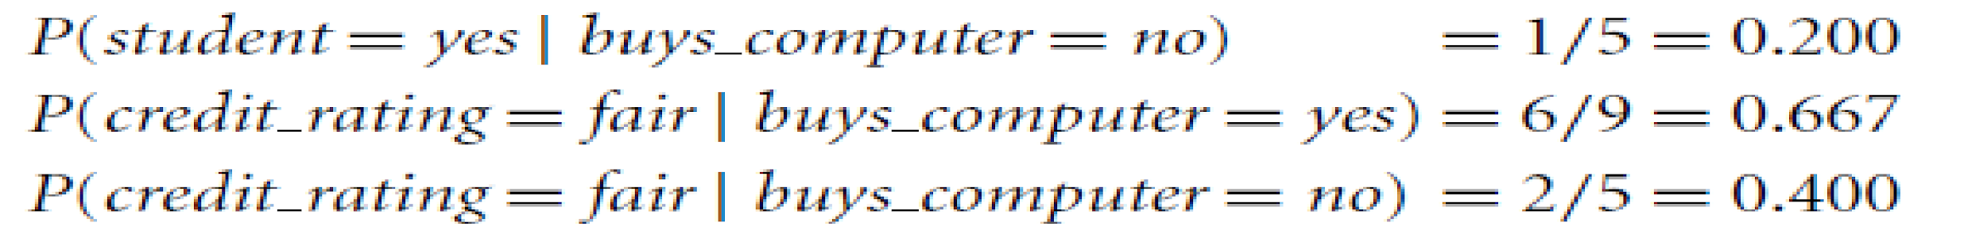
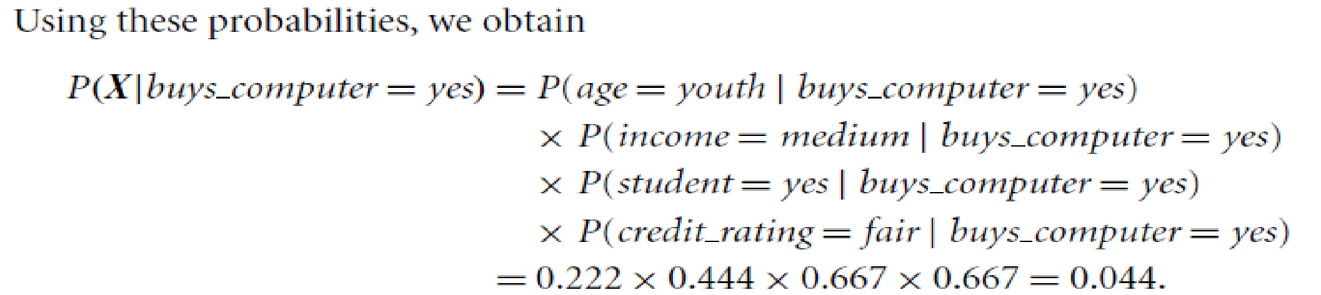
Example: Predicting a class label using Naïve Bayesian classification
We need to maximize P(X|Ci) x P(Ci), for i = 1, 2.
Lets compute P(Ci), the prior probability of each class based on the training tuples as:
P(C1) = P(buys computer = yes) = 9/14 = 0.643
P(C2) = (buys computer = no) = 5/14 = 0.357
‹#›

Slide 15
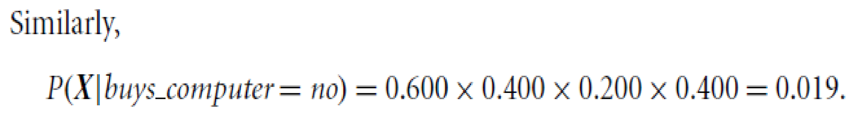
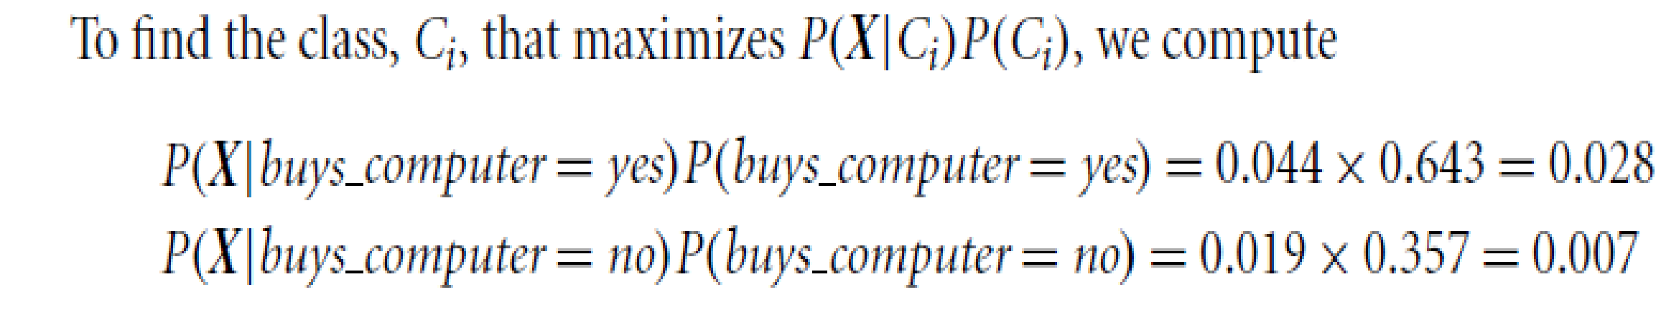
Example: Predicting a class label using Naïve Bayesian classification
‹#›

Slide 16
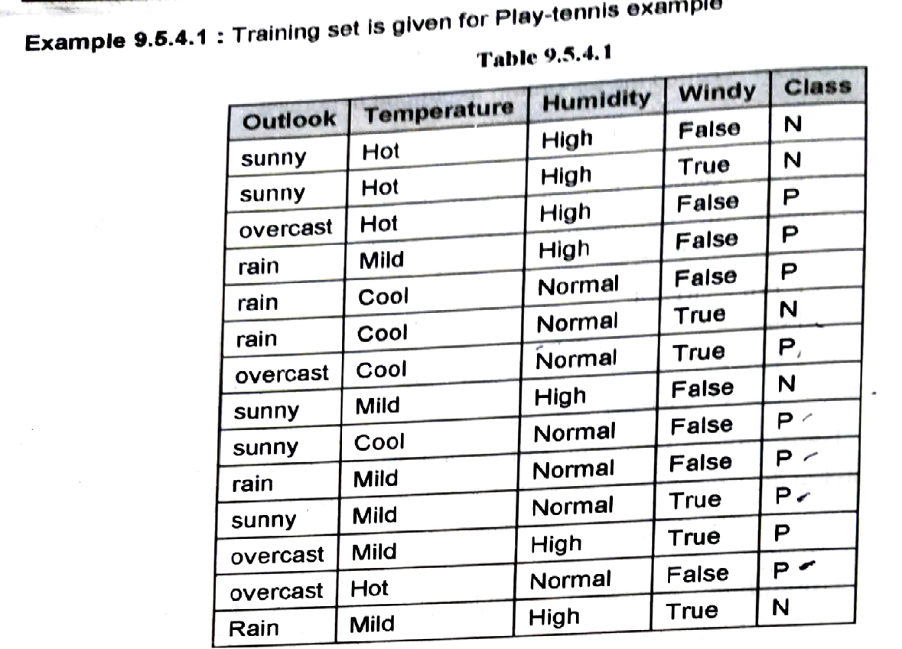
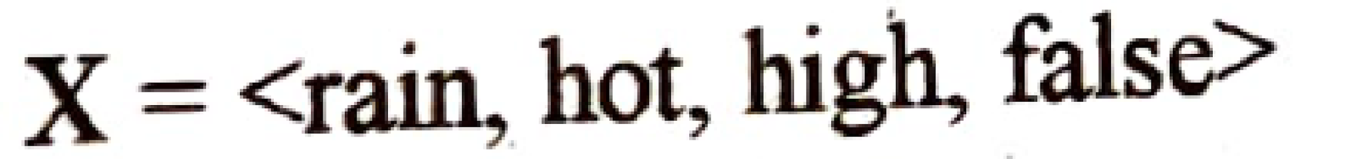
Example:
‹#›

Slide 17
Example: Predicting a class label using Naïve Bayesian classification
We need to maximize P(X|Ci) P(Ci), for i = 1, 2.
Compute P(Ci), the prior probability of each class based on the training tuples as:
P(C1) = P(Class= P) =9/14
P(C2) = (Class=N) =5/15
To compute P(X | Ci) , for i=1,2,…., compute conditional probabilities:
P(Outlook=rain | calss=P) =
P(Outlook=rain | calss=N) =
P(Temp=Hot | calss=P) =
P(Temp=Hot | calss=N) =
P(Humidity=high| calss=P) =
P(Humidity=high| calss=N) =
P(Windy=false| calss=P) =
P(Windy=false| calss=P) =
Use these probabilities and find P(X|Class=P) and P(X|Class= N)
To find the class Ci that maximizes P(X|Ci)P(Ci) ,
Compute P(X|Class=P).P(Class=P) and P(X|Class=N).P(Class=N)
‹#›

Slide 18
Example: Predicting a class label using Naïve Bayesian classification
We need to maximize P(X|Ci) P(Ci), for i = 1, 2.
Compute P(Ci), the prior probability of each class based on the training tuples as:
P(C1) = P(Class= P) =9/14
P(C2) = (Class=N) =5/15
To compute P(X | Ci) , for i=1,2,…., compute conditional probabilities:
P(Outlook=rain | calss=P) =3/9
P(Outlook=rain | calss=N) =2/5
P(Temp=Hot | calss=P) =2/9
P(Temp=Hot | calss=N) =2/5
P(Humidity=high| calss=P) =3/9
P(Humidity=high| calss=N) =4/5
P(Windy=false| calss=P) =6/9
P(Windy=false| calss=P) = 2/5
To find the class Ci that maximizes P(X|Ci)P(Ci) ,
Compute P(X|Class=P).P(Class=P) and P(X|Class=N).P(Class=N)
P(X|Class=P).P(Class=P) = 0.010582 and
P(X|Class=N).P(Class=N) = 0.018286
Hence X is classified with Class= N
‹#›

Slide 19
Applications of Naive Bayes Algorithm
It is used for Credit Scoring.
It is used in medical data classification.
It can be used in real-time predictions because Naïve Bayes Classifier is an eager learner.
It is used in Text classification such as Spam filtering and Sentiment analysis.

Slide 20
Advantages of Naive Bayes Algorithm
Advantages of Naïve Bayes Classifier:
Naïve Bayes is one of the fast and easy ML algorithms to predict a class of datasets.
It can be used for Binary as well as Multi-class Classifications.
It performs well in Multi-class predictions as compared to the other Algorithms.
It is the most popular choice for text classification problems where the dataset is multidimensional.

Slide 21
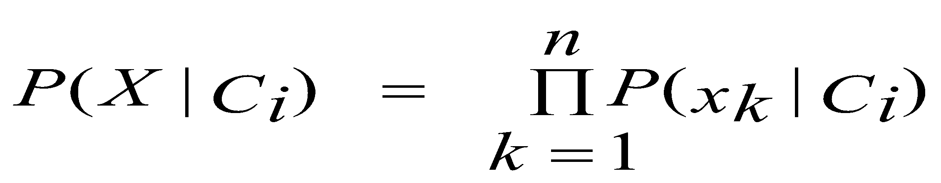
Avoiding the 0-Probability Problem
Naïve Bayesian prediction requires each conditional prob.to be non-zero. Otherwise, the predicted prob. will be zero
We can assume that our training dataset, D, is so large that adding one to each count that we need would only make a negligible difference in the estimated probability value, yet would conveniently avoid the case of probability values of zero. This technique for probability estimation is known as the Laplacian correction or Laplace estimator
Ex. Suppose a dataset with 1000 tuples, income=low (0), income= medium (990), and income = high (10),
Use Laplacian correction (or Laplacian estimator)
Adding 1 to each case
Prob(income = low) = 1/1003
Prob(income = medium) = 991/1003
Prob(income = high) = 11/1003
The “corrected” prob. estimates are close to their “uncorrected” counterparts,yet zero probability value is avoided.
‹#›

Slide 22
Naïve Bayesian Classifier: Comments
Disadvantages
Assumption: class conditional independence, therefore loss of accuracy
Practically, dependencies exist among variables
E.g., hospitals: patients: Profile: age, family history, etc.
Symptoms: fever, cough etc., Disease: lung cancer, diabetes, etc.
Dependencies among these cannot be modeled by Naïve Bayesian Classifier
How to deal with these dependencies?
Bayesian Belief Networks - allows a subset of the variables to be conditionally independent
‹#›

Slide 23
Naïve Bayesian Classifier: Disadvantages
Disadvantages
Assumption: class conditional independence, therefore loss of accuracy
Practically, dependencies exist among variables or attributes.
How to deal with these dependencies?
Bayesian Belief Networks –allows a subset of the variables to be conditionally independent
‹#›

